Slide 1
Resource Sharing on Adhoc Networks
Sanyam Mehta - 2014B4A70526G
Sneha Madle – 2015B5A70705G

Slide 2
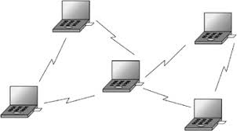
Summary Slide
Introduction
Existing Technology
Functionality of our project
Progress until now
How it is implemented
Future plans and the algorithm to implement it.

Slide 3
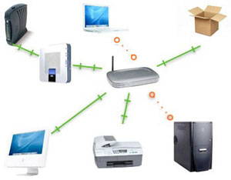
Introduction
Motivation for the project ?
To get more computing power, To ensure that your program runs on different platforms and OS the same way.
Meanwhile your system is free to do anything
Also you can remotely save your work and login from any system and just start working.

Slide 4
Existing Technology
Remote Compilers –the compiler is controlled remotely by the user by using a web browser. One of the project implements a fp web so that one can compile application on any web server using HTTP.
Advantage is that there are no firewall issues, no requirement for SSH/Telnet and is economic.
Disadvantage is that it not available for gcc compiler or python compiler etc.
No direct use of sockets, uses HTTP to simply pipe the data.
Online Compilers like code Bunk – we always need to be connected to the internet even use to compilers like gcc python etc., also the working of the site depends on your data connectivity.

Slide 5
Functionality and Working
Our project aims to provide local resource sharing by connecting to the Adhoc network .
All the systems are connected via Wi-Fi.
Multi user facility to connect and use the resources at the same time on any connected system.
Multiple file transfer.
Use of sockets and Java programming language.

Slide 6


1. Register services
2. Find services
Main Server
10.1.0.1
3. Get IP
4. File Transfer
5. Command
6. Output
PC – A (Host)
10.1.0.2
PC – B (Client)
10.1.0.3

Slide 7
Thank You !

